Slide 1
Sea Fog Detection from GOCI Images using Convolutional Neural Network Transfer Learning Models
Research Report: Application of Deep Learning on Satellite Remote Sensing
Jonathan Edwin
Academic Advisor: 양찬수
Mentor: 전호군 (satellite rs) & 김승룡 (dEEp Learning )

Slide 2
Contents
Introduction
Sea Fog
GOCI
Convolutional Neural Network
Transfer learning
Methodology
Data Processing
Image Augmentation
Dataset
Training and Validating Models
Problem with 8 bands
Result & Conclusion
Future Plans for this Research
My Plans and Impression
References

Slide 3
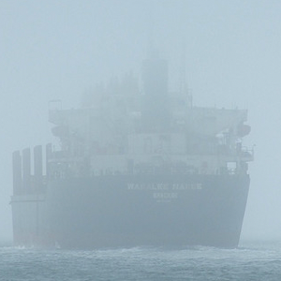
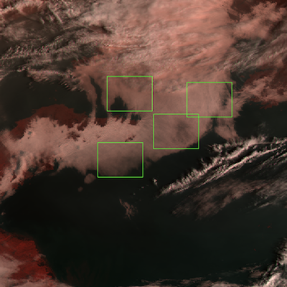
Introduction:
What is Sea Fog?
Fig. 1. Ship inside a sea fog
Sea fog causes 29.5% of total marine accidents in South Korea.^{[1]}
It’s really important to detect and nowcasting of sea fog for maritime safety. ^{[1]}
From GOCI Images we can identify sea fog presence.
It is hard sometimes to distinguish between sea fog and cloud.
Source: AutoMATE Marine^{[3]}
Fig. 2. Sea Fog in GOCI Image
Source: Marine Safety Research Center, KIOST

Slide 4
Introduction:
What is GOCI Images?
Fig. 3. Target Area of GOCI
GOCI: Geostationary Ocean Color Imager
One of the three payloads onboard the Communication, Ocean and Meteorological Satellite (COMS)
8 spectral bands (6 visible, 2 NIR)
Spatial resolution : 500 meters
8 GOCI Images per day- 09:15 ~ 16:15(KST)
Source of Information & Picture: KOSC KIOST^{[5]}

Slide 5
Introduction:
What is Convolutional Neural Network ?
Fig. 4. VGG19 Architecture
Convolutional Neural Network also known as CNN
CNN is one of deep learning model by taking an image as the input and extract features like color and shape to do image classification
In this research, we are using VGG19 and ResNet50 model.
Source: Researchgate^{[5]}

Slide 6
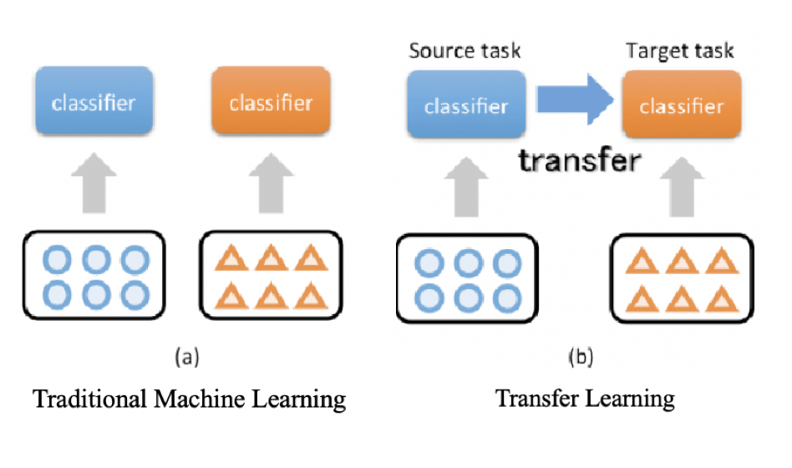
Introduction:
What is Transfer Learning?
Fig. 5. Transfer Learning
Transfer learning is a machine learning method where a model developed for a task is reused as the starting point for a model on a second task.
In this experiment, models had learned from ImageNet Dataset
ImageNet Dataset contains 1.2 million images with 1000 classes
Source: Research Gate^{[4]}

Slide 7
Methodology:
Fig. 6. Flow Chart of the experiment
Flow Chart
Start
GOCI L1B Images
Extract 100x100 pixel images that have sea fog, cloud and others (land and ocean)
Do Image Augmentation (Rotation and flip)
Separate it into train folder and test folder where each folder has sub-folders contain Sea Fog folder, Cloud and Others folder with total 100 images for training and 20 for validation per class.
Training and Validating CNN models (VGG19-Transfer Learning, VGG19- without Transfer Learning, ResNet50-Transfer Learning, and ResNet50- without Transfer Learning)
Comparing CNN models result
Extracting 3 bands (Band 8, 2, 1) 100x100 pixel as PNG images
Extracting 8 bands 100x100 pixel as TIFF images
Image Augmentation
(Rotation & Flip)
Image Augmentation
(Rotation & Flip)
Training Images with 3 sub folder (Sea fog, Cloud, & Others)
Validation Images with 3 sub folder (Sea fog, Cloud, & Others)
Training Images with 3 sub folder (Sea fog, Cloud, & Others)
Validation Images with 3 sub folder (Sea fog, Cloud, & Others)
Training & Validating CNN models
(VGG19-Transfer Learning, VGG19- without Transfer Learning, ResNet50-Transfer Learning, and ResNet50- without Transfer Learning)
Comparing CNN model result
End

Slide 8
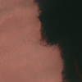
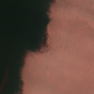
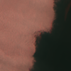
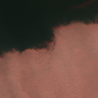
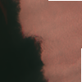
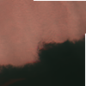
Methodology:
Image Augmentation
Table 1. Image Augmentation
Image | Condition
 | Original
 | Horizontal Flip
 | Vertical Flip
 | Rotate 90°
 | Rotate 180°
 | Rotate 270°
Image data augmentation is a technique that can be used to artificially increase the amount of a dataset by creating modified versions of images in the dataset.
In this experiment, we try to horizontal, vertical flip, rotate 90º, 180º and 270º
From 100 images per class, we can get 600 images per class by do Image Augmentation

Slide 9

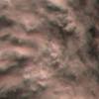

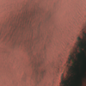
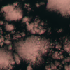
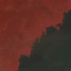

Methodology:
Dataset Analysis
Table 2. Dataset contains this kind of images
Sea Fog | Clouds | Others
Only Sea fog | Only clouds | Only land
Sea fog and little bit ocean | Clouds and little bit Ocean | Land and Ocean
 |  | Only Ocean

Slide 10
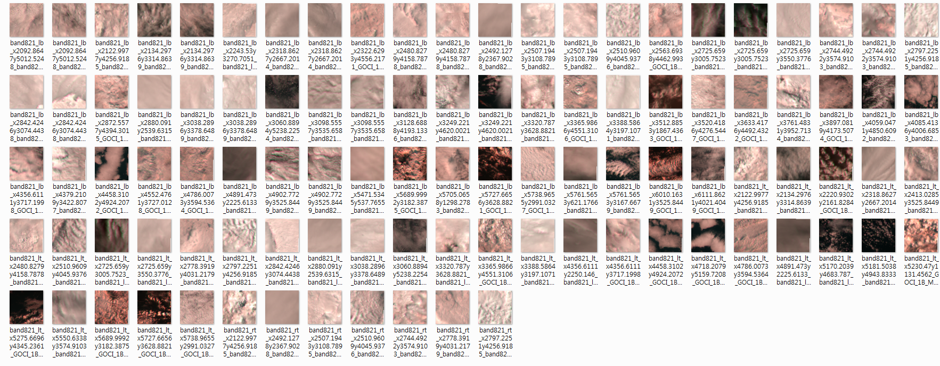
Fig. 7. 100X100 Pixels Images in Training folder for Cloud class (100 Images)
Methodology:
Dataset of Cloud for Training

Slide 11
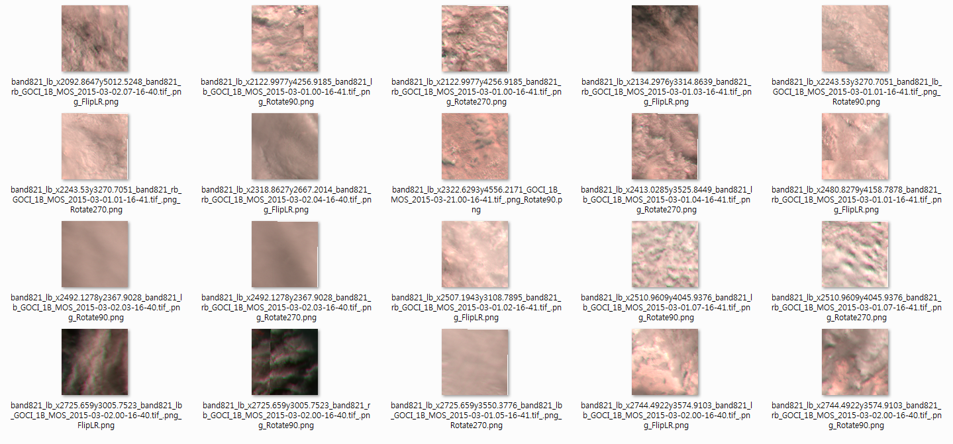
Methodology:
Dataset of Cloud for Validation
Fig. 8. 100X100 Pixels Images in Validation folder for Cloud class (20 Images)

Slide 12
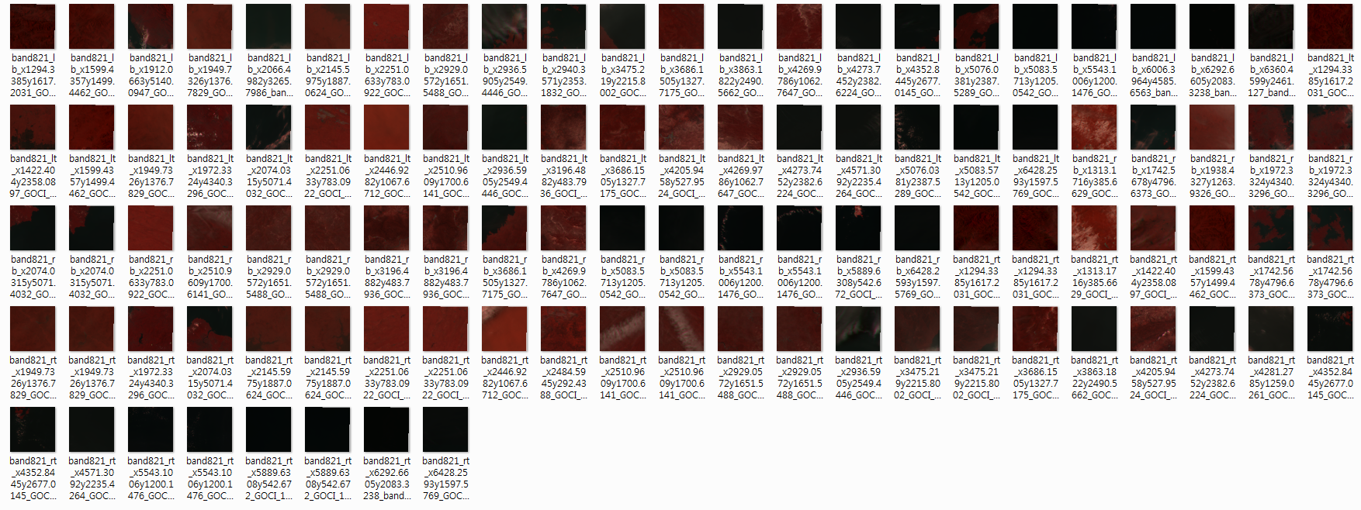
Methodology:
Dataset of Others for Training
Fig. 9. 100X100 Pixels Images in Training folder for Others class (100 Images)

Slide 13
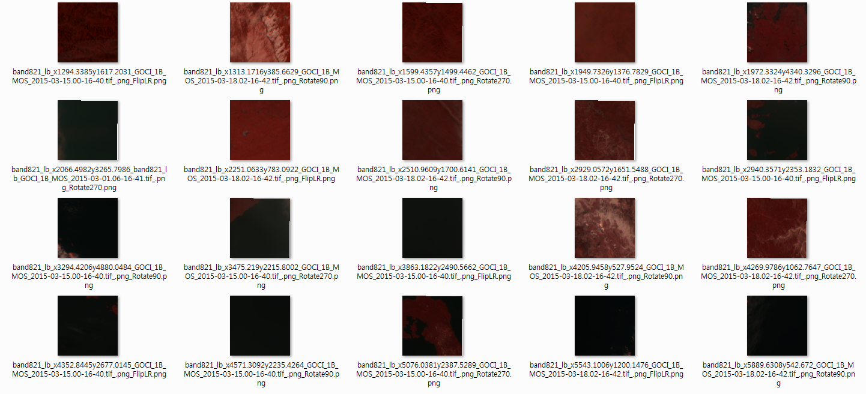
Methodology:
Dataset of Others for Validation
Fig. 10. 100X100 Pixels Images in Validating folder for Others class (20 Images)

Slide 14
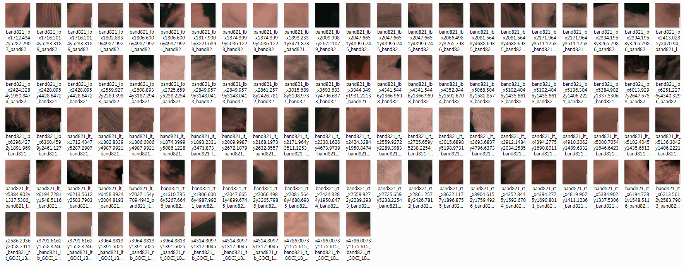
Methodology:
Dataset of Sea Fog for Training
Fig. 11. 100X100 Pixels Images in Training folder for Sea fog class (100 Images)

Slide 15
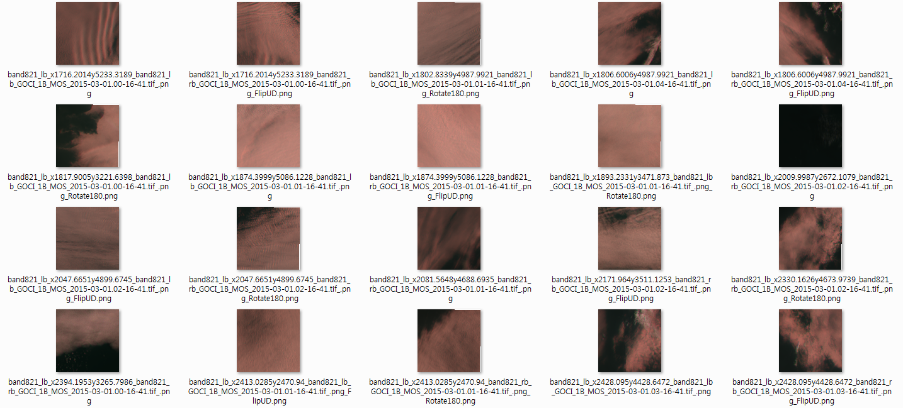
Methodology:
Dataset of Sea Fog for Validation
Fig. 12. 100X100 Pixels Images in Validation folder for Sea fog class (20 Images)

Slide 16
Training and Validation Models
The model was created in python based Keras framework.
Training Epoch means how many iteration the model learn from the data
Batch Size is how many images are being learn in 1 batch
Optimizer is a mathematical approach to reduce the error rate from the model
Learning Rate controls how quickly or slowly a model learns
Activation Function is a function to make the model become non-linear
Table 3. Parameter of CNN models
Parameter | Value
Training Epoch | 10
Batch Size | 15
Optimizer | Adam
Learning Rate | 0.001
Activation Function | ReLU and SoftMax (Classifier layer)

Slide 17




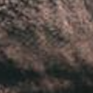

Accuracy and Validation Accuracy
Fig. 17 Difference between Accuracy and Validation Accuracy
Validation
Accuracy
Accuracy
Sea Fog
Sea Fog
Model
learn and classify images
Model classify images
Clouds
Clouds
Others
Others
300 Images of Training
60 New Images of Validation

Slide 18
Result & Conclusion
Table 4. Result of Experiment
Bands | Model | Accuracy | Validation Accuracy
3 Bands | VGG19 | 85.3% | 83.3%
 | VGG19 with Transfer Learning | 96.67% | 91.67%
 | ResNet50 | 52% | 53.3%
 | ResNet50 with Transfer Learning | 93% | 95%
5 Bands | VGG19 | 72% | 82.7%
5+1 Bands(A) | VGG19 | 67.7% | 73.3%
5+1 Bands(B) | VGG19 | 73.7% | 75.0%
8 Bands | VGG19 | 68.3% | 71.6%
 | ResNet50 | 58.3% | 51.7%
Model with transfer learning had a higher accuracy than without transfer learning
Transfer learning method only can be used for 3 bands images
VGG19 model has a small difference of accuracy between the transfer learning model and without transfer learning, so it becomes a good option to use this architecture for sea fog detection with 8 bands images.
TL : Transfer Learning
5+1 Bands(A): 5 Bands + ratio(band1/band8)
5+1 Bands(A): 5 Bands + mean(band1+..+band8)

Slide 19
Future Plans for this Research
Fig. 18. Comparison between image classification, object detection and instance segmentation.
Experiment with different CNN architecture
Classification + Localization of sea fog
Object Detection (Sea fog, Cloud, Land, Ocean)
Sea fog Image Segmentation
Predict Sea Fog movement
Source: Medium^{[9]}

Slide 20
My Plans and Impression
Plans
Impression
Going back to Indonesia (Sunday)
Rest for a week
Continue my study in Indonesia (Monday next 2 weeks)
Become a mentor for freshman students at my faculty
Proven that the Earth is round
Experience to use high specification of computers
Extraordinary experience to process satellite images
Experience Korean research environment
UST is one of the option to study higher degree

Slide 21
References
[1] Rashid, A., & Yang, C. (2018). A simple sea fog prediction approach using GOCI observations and sea surface winds. Remote Sensing Letters 9(1):21-31
[2] Rashid, A., & Yang, C. (2016). Estimation of Sea Fog Movement Using Satellite Data and 20-km WRF Wind Field in the East Sea from February to April in 2014. DOI: 10.20481/kscdp.2016.3.3.128
[3] AutoMATE Marine Systems. http://automatemarine.com/news/advanced-fuel-saving-rudder-control-all-sea-states-rough-seas/ Last accessed Aug 16,2019
[4] Heo, k., Park, S., Ha, K., Shim, J. (2012). Algorithm for Sea Fog Monitoring with the Use of Information Technologies. Royal Meteorological Society
[5] Korea Ocean Satellite Center. COMS-GOCI: Introduction. http://kosc.kiost.ac.kr/p20/kosc_p21.html Last accessed Aug 16, 2019
[6] Zheng Y., Yang, C.(2018). Breast Cancer Screening using Convolutional Neural Network and Follow-up Digital Mammography. Conference Paper
[7] Suzuki, M., Sato, H., Oyama, S., Kurihara, M. (2014). Transfer Learning based on the Oberservation Probability of Each Attribute. Conference Paper
[8] Keras Team. https://github.com/keras-team/keras-applications/blob/master/keras_applications/vgg19.py Last accessed Aug 16, 2019
[9] Ouaknine A.(2018). Review of Deep Learning Algorithms for Object Detection. https://medium.com/zylapp/review-of-deep-learning-algorithms-for-object-detection-c1f3d437b852 Last accessed Aug 16, 2019

Slide 22
Thank You 감사합니다 Terima Kasih

